Slide 1

UNIT III
Dr. roshan d suvaris

Slide 2
React State
  we only saw static components, that is, components that did not change. To make components that respond to user input and other events, React uses a data structure called state in the component.
  The state essentially holds the data, something that can change, as opposed to the immutable properties in the form of props that you saw earlier.
  This state needs to be used in the render() method to build the view. It is only the change of state that can change the view. When data or the state changes, React automatically rerenders the view to show the new changed data.

Slide 3
Initial State (program9InitialState)
  The state of a component is captured in a variable called this.state in the component’s class, which should be an object consisting of one or more key-value pairs, where each key is a state variable name and the value is the current value of that variable.
  React does not specify what needs to go into the state, but it is useful to store in the state anything that affects the rendered view and can change due to any event. These are typically events generated due to user interaction.
  For the IssueTable component, the list of issues being displayed is definitely one such piece of data that both affects the rendered view and can also change when an issue is added, edited, or deleted. The array of issues is therefore an ideal state variable.
  There may be cases where it does affect the DOM; for example, if the height of the window determines how many issues we display, we may store the height of the window in a state variable and restrict the number of IssueRow components being constructed. In those cases, the height of the window, or a derived value, for example, the number of issues being shown, could also be stored in the state.
  Things that don’t change, for example, the border style of the table, also don’t need to go into the state. That’s because user interaction or other events do not affect the style of borders.

Slide 4
    let’s just use an array of issues as the one and only state of the component and use that array to construct the table of issues.
    Thus, in the render() method of IssueTable, let’s change the loop that creates the set of IssueRows to use the state variable called issues rather than the global array like this:
            ...
            const issueRows = this.state.issues.map(issue =>
            <IssueRow key={issue.id} issue={issue} />
            ...
    As for the initial state, let’s use a hard-coded set of issues and set it to the initial state.
            ...
            const initialIssues = [
            ...
            ];
    Setting the initial state needs to be done in the constructor of the component. This can be done by simply assigning the variable this.state to the set of state variables and their values.
      ...
      this.state = { issues: initialIssues };
      ...

Slide 5
    Note that we used only one state variable called issues. We can have other state variables, for instance if we were showing the issue list in multiple pages, and we wanted to also keep the page number currently being shown as another state variable, we could have done that by adding another key to the object like page: 0.
    The set of all changes to use the state to render the view of IssueTable is shown in Listing
    Listing 4-1. App.jsx: Initializing and Using State
        ...
        const issues = [
        const initialIssues = [
        {
        id: 1, status: 'New', owner: 'Ravan', effort: 5,
        created: new Date('2018-08-15'), due: undefined,
        },
        ...
        class IssueTable extends React.Component {
        constructor() {
        super();
        this.state = { issues: initialIssues };
        }
        render() {
        const issueRows = issues.map(issue =>
        const issueRows = this.state.issues.map(issue =>
        <IssueRow key={issue.id} issue={issue} />
        );
        ...

Slide 6
Async State Initialization
This section explains Async State Initialization in React. The key idea is that the initial state is usually not hard-coded; instead, it is obtained asynchronously from a server through an API call.
Initial State
  Previously, the IssueTable initialized its state using a hard-coded initialIssues array.
  In a real Single Page Application (SPA), data is normally obtained from a server.
Fetching Data from Server
  The initial list of issues should be retrieved through an API call.
  Since API communication takes time, the data is obtained asynchronously.
State During API Call
  When the component is first created, the issue data may not yet be available.
  The component can initially have an empty issues array.
Updating State
  After the server responds with the issue data, the component's state is updated.
  React then automatically re-renders the IssueTable with the fetched issues.

Slide 7
  The state can only be assigned a value in the constructor. After that, the state can be modified, but only via a call to React.Component’s this.setState() method.
  This method takes in one argument, which is an object containing all the changed state variables and their values.
  The only state variable that we have is the one called issues, which can be set to any list of issues in a call to this.setState() like this:
      ...
      this.setState({ issues: newIssues });
      ...
  If there were additional state variables, setting only one variable (issues) will cause it to get merged with the existing state.
  For example, if we had stored the current page as another state variable, the new value of the state variable issues will be merged into the state, keeping the value of the current page unchanged.
  Since at the time of constructing the component, we don’t have the initial data, we will have to assign an empty array to the issues state variable in the constructor.
      ...
      constructor() {
      this.state = { issues: [] };
      ...

Slide 8
  The key difference between a global array of issues and a call to the server is that the latter needs an asynchronous call.
  Let’s add a method to the IssueTable class that asynchronously returns an array of issues.
  we’ll use a setTimeout() call to make it asynchronous.
  In the callback to the setTimeout() call (which will eventually be an Ajax call), let’s call this.setState() with the static array of initial issues like this:
      ...
      loadData() {
      setTimeout(() => {
      this.setState({ issues: initialIssues });
      }, 500);
      }
      ...
  The timeout value of 500 milliseconds is somewhat arbitrary: it’s reasonable to expect a real API call to fetch the initial list of issues within this time.

Slide 9
Now, it is very tempting to call loadData() within the constructor of IssueTable.
It may even seem to work, but the fact is that the constructor only constructs the component (i.e., does all the initialization of the object in memory) and does not render the UI.
The rendering happens later, when the component needs to be shown on the screen. If this.setState() gets called before the component is ready to be rendered, things will go awry.
You may not see this happening in simple pages, but if the initial page is complex and takes time to render, and if the Ajax call returns before rendering is finished, you will get an error.
React provides many other methods called lifecycle methods to cater to this and other situations where something needs to be done depending on the stage, or changes in the status of the component. Apart from the constructor and the render() methods, the following lifecycle methods of a component could be of interest:
  componentDidMount():
  componentDidUpdate():
  componentWillUnmount():
  shouldComponentUpdate():

Slide 10
• componentDidMount(): This method is called as soon as the component’s representation has been converted and inserted into the DOM. A setState() can be called within this method.
• componentDidUpdate(): This method is invoked immediately after an update occurs, but it is not called for the initial render. this.setState() can be called within this method. The method is also supplied the previous props and previous state as arguments, so that the function has a chance to check the differences between the previous props and state and the current props and state before taking an action.
• componentWillUnmount(): This method is useful for cleanup such as cancelling timers and pending network requests.
• shouldComponentUpdate(): This method can be used to optimize and prevent a rerender in case there is a change in the props or state that really doesn’t affect the output or the view. This method is rarely used because, when the state and props are designed well, there will rarely be a case when the state or props change but an update is not required for the view.

Slide 11
The best place to initiate the loading of data in this case is the componentDidMount() method. At this point in time, the DOM is guaranteed to be ready, and setState() can be called to rerender the component.
  ...
  componentDidMount() {
  this.loadData();
  }
  ...

Slide 12
The complete set of changes in the IssueTable class is shown in Listing
...
class IssueTable extends React.Component {
constructor() {
super();
this.state = { issues: initialIssues };
this.state = { issues: [] };
}
componentDidMount() {
this.loadData();
}
loadData() {
setTimeout(() => {
this.setState({ issues: initialIssues });
}, 500);
}
...
  If you refresh the browser (assuming you’re still running npm run watch and npm start on two different consoles), you will find that the list of issues is displayed as it used to be in the previous steps. But, you will also see that for a fraction of a second after the page is loaded, the table is empty

Slide 13
App.jsx
const initialIssues = [
{
id: 1,
status: "New",
owner: "Rohan",
effort: 5
},
{
id: 2,
status: "Assigned",
owner: "Priya",
effort: 10
}
];
class IssueTable extends React.Component {
constructor() {
super();
this.state = { issues: [] };
}
componentDidMount() {
this.loadData();
}
loadData() {
setTimeout(() => {
this.setState({
issues: initialIssues
});
}, 500);
}
render() {
return (
<div>
<h2>Issue Tracker</h2>
{this.state.issues.map(issue => (
<div key={issue.id}>
{issue.id} - {issue.status} - {issue.owner}
</div>
))}
</div>
);
}
}
ReactDOM.render(
<IssueTable />,
document.getElementById("contents")
);

Slide 14
Updating State
1. Updating State
In React, the state is initially assigned in the constructor and can later be changed using the this.setState() method. When only a part of the state needs to be changed, we should not directly modify the existing state variable.
2. State Should Be Treated as Immutable
The this.state object should always be treated as immutable. We should not directly modify the state or its contents.
For example, the following is incorrect:
  this.state.issues.push(issue);
React may not detect this change because the state was modified directly without using setState().

Slide 15
3. Why setState() Is Required
The this.setState() method tells React that the state has changed. React can then compare the previous state with the new state and automatically re-render the component and update the required parts of the UI.
Therefore, state changes should always be performed through:
  this.setState(...)
4. Do Not Modify the Original Array
Even the following approach should be avoided:
    let issues = this.state.issues;
    issues.push(issue);
    this.setState({
    issues: issues
    });
Here, issues is still referring to the original state array. Therefore, the original state has been modified.
Instead, we should first create a new copy of the array.

Slide 16
5. Creating a Copy Using slice()
The slice() method creates a shallow copy of the existing array:
  const newIssueList = this.state.issues.slice();
We can then add the new issue to this new array:
  newIssueList.push(issue);
Finally, update the state:
  this.setState({
  issues: newIssueList
  });
The original state array remains unchanged.

Slide 17
6. Creating a New Issue
The createIssue() method receives an issue object as an argument. It assigns a new ID and creation date to the issue.
  createIssue(issue) {
  issue.id = this.state.issues.length + 1;
  issue.created = new Date();
  const newIssueList = this.state.issues.slice();
  newIssueList.push(issue);
  this.setState({
  issues: newIssueList
  });
  }

Slide 18
7. Using setTimeout() to Simulate Adding an Issue
Instead of creating a user interface and event handling at this stage, the example uses setTimeout() to add a sample issue automatically after 2 seconds.
  setTimeout(() => {
  this.createIssue(sampleIssue);
  }, 2000);
This simulates an event that causes the state to change.
8. React Automatically Updates Child Components
When IssueTable updates its state, React automatically passes the changed data to its child components such as IssueRow.
We do not need to manually call setState() on the child component.
React also calculates the difference between the old and new Virtual DOM and updates only the required part of the actual DOM.

Slide 19
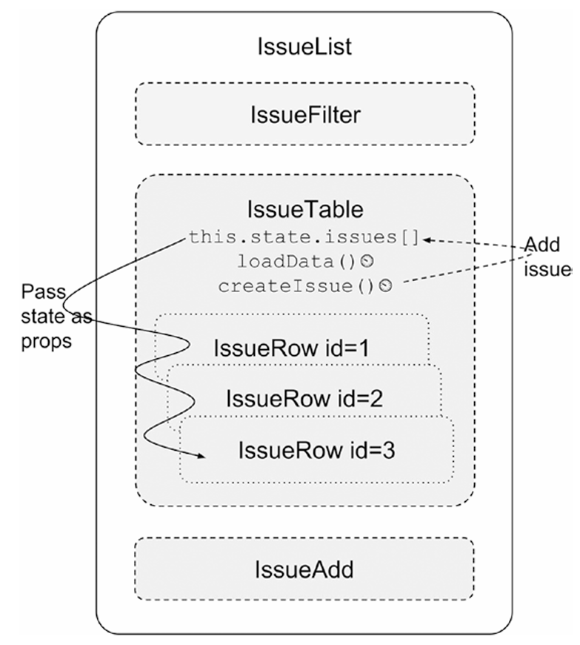
At this point, the hierarchy of the components and the data flow can be visually depicted, as shown in Figure

Slide 20
Lifting State Up
  explains how to pass a function from a parent component to a child component.
What was the problem?
  The application has three components:
  IssueList
  ├── IssueAdd
  └── IssueTable
  Think of them like this:
  IssueList → Parent component
  IssueAdd → Child component for adding an issue
  IssueTable → Child component for displaying issues
  Initially, the issues data and the createIssue() method were inside IssueTable.
  But now we want the IssueAdd component to create a new issue.

Slide 21
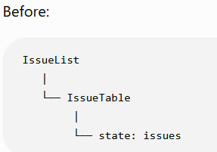
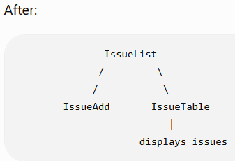
The problem is:
  IssueAdd and IssueTable are siblings.
  React does not normally allow one sibling to directly communicate with another sibling.
How do we solve this?
  We move the state to their common parent.
  Now IssueList owns the issues state.
  This is called: Lifting State Up
  Lifting state up means moving shared state from a child component to their common parent component.

Slide 22
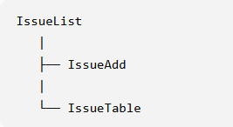
Why move the state to IssueList?
  Because both components need the issue information:
  IssueAdd needs to create an issue.
  IssueTable needs to display the issues.
  Therefore, IssueList becomes the central place that manages the issue data.

Slide 23
  Problem:
  IssueAdd and IssueTable are sibling components. IssueAdd needs to add a new issue, while IssueTable needs to display the issues.
  Since sibling components do not directly share state, we move the common state to their parent component, IssueList.
  1. Move State to the Parent
    Instead of keeping issues inside IssueTable, keep it inside IssueList.
    class IssueList extends React.Component {
    constructor() {
    super();
    this.state = {
    issues: []
    };
    }
    }
  Now, IssueList becomes the owner of the issues data.

Slide 24
2. Pass Data to IssueTable
IssueList sends the issues to IssueTable using props.
<IssueTable issues={this.state.issues} />
Inside IssueTable:
const issueRows = this.props.issues.map(issue =>
<IssueRow key={issue.id} issue={issue} />
);
So the data flows:
IssueList → IssueTable

Slide 25
3. Pass Function to IssueAdd
IssueList also sends the createIssue() function to IssueAdd.
<IssueAdd createIssue={this.createIssue} />
Inside IssueAdd, the function can be called:
this.props.createIssue(sampleIssue);
So the function flows:
IssueList → IssueAdd

Slide 26
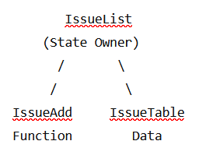
Why Do We Do This?
  If IssueTable owns the state, IssueAdd cannot easily update that state because they are siblings.
  By moving the state to their common parent:
  IssueList becomes the single source of truth.
  It can:
  store the issues
  add new issues
  send issues to IssueTable
  send createIssue() to IssueAdd

Slide 27
Event Handling
Event Handling in React
  React allows us to respond to user actions such as clicking a button, submitting a form, typing, etc.
  Event handlers are written using properties such as: onClick, onSubmit, onChange
  In the Issue Tracker, we use the form submission event to add a new issue.
Creating the Issue Form
  Instead of creating an issue automatically using a timer, we allow the user to enter the details.
  The form contains:
  Owner – name of the person responsible
  Title – description of the issue
  Add button – submits the form
    Example:
    <form>
    <input type="text" name="owner" placeholder="Owner" />
    <input type="text" name="title" placeholder="Title" />
    <button>Add</button>
    </form>

Slide 28
Handling Form Submission
  When the user clicks Add, the form normally submits and reloads the page.
  We don't want this.
  So, we use:
  <form name="issueAdd" onSubmit={this.handleSubmit}>
  Here:
  onSubmit connects the form to handleSubmit().
  handleSubmit() is executed when the form is submitted.
Preventing Default Form Submission
  Inside handleSubmit():
    handleSubmit(e) {
    e.preventDefault();
    }
  e.preventDefault() stops the browser's normal form submission.
  This allows React to handle the event itself without reloading the page.

Slide 29
Reading Form Values
  We can access the form using:
  const form = document.forms.issueAdd;
  Then retrieve the values:
    form.owner.value
    form.title.value
  For example, if the user enters:
    Owner: Ravi
    Title: Login Problem
  We can create:
    const issue = {
    owner: form.owner.value,
    title: form.title.value,
    status: 'New'
    };

Slide 30
Adding the Issue
  The new issue is sent to the parent component using the callback passed through props:
    this.props.createIssue(issue);
  The flow is:
    User enters data
    ↓
    Clicks Add
    ↓
    handleSubmit()
    ↓
    Create issue object
    ↓
    createIssue() in IssueList
    ↓
    State is updated
    ↓
    IssueTable displays new issue

Slide 31
Clearing the Form
  After adding the issue, the input fields are cleared:
  form.owner.value = "";
  form.title.value = "";
  This makes the form ready to enter another issue.
Binding the Event Handler
  Since handleSubmit() is called as an event handler, we bind it in the constructor:
  constructor() {
  super();
  this.handleSubmit = this.handleSubmit.bind(this);
  }
  This ensures that this inside handleSubmit() refers to the IssueAdd component.

Slide 32
Complete IssueAdd Example
  class IssueAdd extends React.Component {
  constructor() {
  super();
  this.handleSubmit = this.handleSubmit.bind(this);
  }
  handleSubmit(e) {
  e.preventDefault();
  const form = document.forms.issueAdd;
  const issue = {
  owner: form.owner.value,
  title: form.title.value,
  status: "New"
  };
  this.props.createIssue(issue);
  form.owner.value = "";
  form.title.value = ""; }
render()
{
return (
<form name="issueAdd" onSubmit={this.handleSubmit}> <input type="text" name="owner" placeholder="Owner" />
<input type="text" name="title" placeholder="Title" /> <button>Add</button> </form> );
}
}

Slide 33
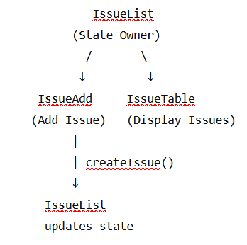
Key Concept – Lifting State Up
IssueAdd does not directly modify the issue list.
  Instead:
  IssueList owns the state.
  IssueAdd receives createIssue() through props.
  IssueAdd calls the function when the user submits the form.
  IssueList updates its state.
  IssueTable receives the updated issues through props.
  Important Points
  onSubmit handles form submission.
  preventDefault() prevents page reload.
  Form values are obtained using form.fieldName.value.
  createIssue() is passed from parent to child through props.
  State remains in the common parent.
  Updated state automatically flows to IssueTable.
  This follows React's one-way data flow.

Slide 34
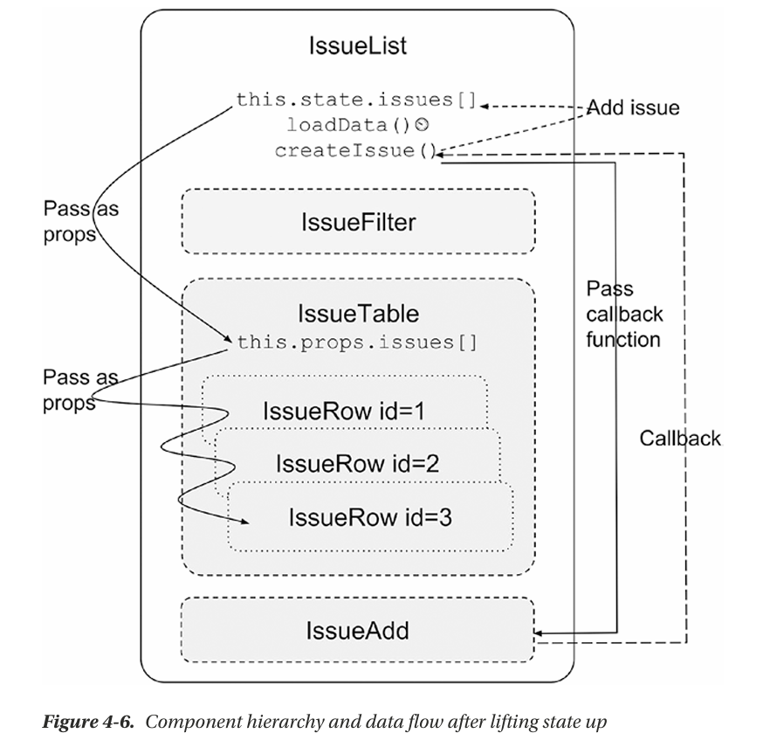

Slide 35
Stateless Components
  What is a Stateless Component?
    A stateless component is a React component that does not maintain its own state.
    Its output depends mainly on the props received from the parent.
    It can be written as a JavaScript function instead of a class.
    It is useful when a component only needs to display data.
  Class Component vs Stateless Component
  A class component:
    class HelloWorld extends React.Component {
    render() {
    return <h1>Hello World!</h1>;
    }
    }
  The same component can be written as a function:
    function HelloWorld() {
    return <h1>Hello World!</h1>;
    }
  The functional version is shorter and easier to understand.

Slide 36
Stateless Component with Props
  If the component receives data through props:
    function HelloWorld(props) {
    return <h1>{props.message}</h1>;
    }
  It can be used as:
    <HelloWorld message="Hello World" />
  Here:
  message is passed from the parent.
  The component does not modify it.
  It simply uses the prop to display the output.
Arrow Function
  A stateless component can also be written using an arrow function:
    const HelloWorld = (props) => (
    <h1>{props.message}</h1>
    );
  This is a shorter form of a functional component.

Slide 37
  IssueRow as a Stateless Component
  IssueRow only receives an issue and displays its information.
    function IssueRow(props) {
    const issue = props.issue;
    return (
    <tr>
    <td>{issue.id}</td>
    <td>{issue.status}</td>
    <td>{issue.owner}</td>
    <td>{issue.title}</td>
    </tr>
    );
    }
  It does not:
  maintain state
  modify state
  contain lifecycle methods
  Therefore, it can be written as a function.

Slide 38
IssueTable as a Stateless Component
  IssueTable receives the issues array through props and displays it.
    function IssueTable(props) {
    const issueRows = props.issues.map(issue =>
    <IssueRow
    key={issue.id}
    issue={issue}
    />
    );
    return (
    <table border="1">
    <thead>
    <tr>
    <th>ID</th>
    <th>Status</th>
    <th>Owner</th>
    <th>Title</th>
    </tr>
    </thead>
    <tbody>
    {issueRows}
    </tbody>
    </table>
    );
    }

Slide 39
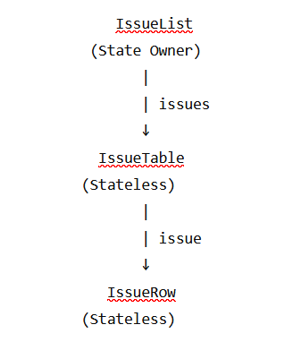
Example of Data Flow
  In the Issue Tracker:
  IssueList maintains the state.
  IssueTable and IssueRow simply receive data through props and display it.

Slide 40
Key Points
  Stateless components do not maintain their own state.
  They generally receive data through props.
  They can be written as functions.
  They are simpler and easier to read.
  They are suitable for components whose main responsibility is rendering UI.
  IssueRow and IssueTable are examples of stateless components.

Slide 41
Designing Components
  Most beginners will have a bit of confusion between state and props, when to use which,
  what granularity of components should one choose, and how to go about it all.
  State vs. Props
    Both state and props hold model information, but they are different.
    The props are immutable, whereas state is not.
    Typically, state variables are passed down to child components as props because the children don’t maintain or modify them.
    They take in a read-only copy and use it only to render the view of the component.
    If any event in the child affects the parent’s state, the child calls a method defined in the parent. Access to this method should have been explicitly given by passing it as a callback via props.
    Anything that can change due to an event anywhere in the component hierarchy qualifies as being part of the state.
    Do not copy props into state, just because props are immutable. If you feel the need to do this, think of modifying the original state from which these props were derived.

Slide 42
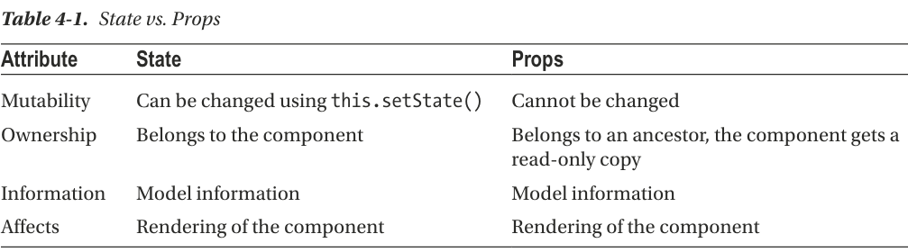
Component Hierarchy
  Split the application into components and subcomponents.
  Typically, this will reflect the data model itself.
  For example, in the Issue Tracker, the issues array was represented by the IssueTable component, and each issue was represented by the IssueRow component.
  Decide on the granularity just as you would for splitting functions and objects.
  The component should be self-contained with minimal and logical interfaces to the parent.
  If you find it doing too many things, just like in functions, it should probably be split into multiple components, so that it follows the Single Responsibility principle
  If you are passing in too many props to a component, it is an indication that either the component needs to be split, or it need not exist

Slide 43
Communication
  Communication between components depends on the direction.
  Parents communicate to children via props; when state changes, the props automatically change.
  Children communicate to parents via callbacks.
  Siblings and cousins can’t communicate with each other, so if there is a need, the information has to go up the hierarchy and then back down – Lifting up state
  If there is a need to know the state of a child in a parent, you’re probably doing it wrong.
Stateless Components
  In a well-designed application, most components would be stateless functions of their properties.
  All states would be captured in a few components at the top of the hierarchy, from where the props of all the descendants are derived.
  We did just that with the IssueList, where we kept the state.
  We converted all descendent components to stateless components, relying only on props passed down the hierarchy to render themselves.
  We kept the state in IssueList because that was the least common component above all the descendants that depended on that state.
  Sometimes, you may find that there is no logical common ancestor. In such cases, you may have to invent a new component just to hold the state, even though visually the component has nothing.

Slide 44
x

Slide 45
x

Slide 46
x

Slide 47
x

Slide 48
x

Slide 49
x

Slide 50
x

Slide 51
x

